Slide 1
SECURE DATA HIDING IN IMAGES USING STEGANOGRAPHY
CAPSTONE PROJECT
Presented By: BALA SUBRAMANIAN
Student Name : BALA SUBRAMANIAN
College Name & Department : Vel Tech High Tech dr.Rangarajan dr.Sakunthala Engineering college & INFORMATION TECHNOLOGY

Slide 2
OUTLINE
Problem Statement
Technology used
Wow factor
End users
Result
Conclusion
Git-hub Link
Future scope

Slide 3
PROBLEM STATEMENT
The project aims to develop a secure steganography system that hides encrypted messages in images using AES encryption and LSB steganography. This ensures that even if the hidden data is extracted, it remains unreadable without the correct decryption key. The system will include a user-friendly GUI for easy encoding and decoding. It provides a confidential communication method by integrating cryptography and image processing to protect sensitive information.

Slide 4
TECHNOLOGY USED
Platforms:
Python – Programming language used for backend development
HTML & CSS – Frontend for user interface design
Localhost (Flask Server) – Runs the application on a web browser
Libraries:
Flask – Web framework for building the backend
OpenCV – Image processing and pixel manipulation
NumPy – Handling numerical operations and array processing

Slide 5
WOW FACTORS
Steganography-based Encryption (Hides messages inside images
Passcode-Protected Decryption (Only authorized users can retrieve messages)
User-Friendly Interface (Easy drag-and-drop encryption & decryption)
Supports Multiple Image Formats (PNG, JPG, etc.)
Secure & Lightweight (Minimal dependencies, works offline)

Slide 6
END USERS
Cybersecurity Professionals – Secure data transmission & covert communication.
Journalists & Activists – Hide sensitive information from surveillance.
Forensic Investigators – Extract hidden data for digital investigations.
Government & Military – Secure confidential communications.
Intellectual Property Owners – Watermarking & copyright protection.
General Users – Private messaging without detection.
This project benefits anyone needing secure, hidden communication in digital images.

Slide 7
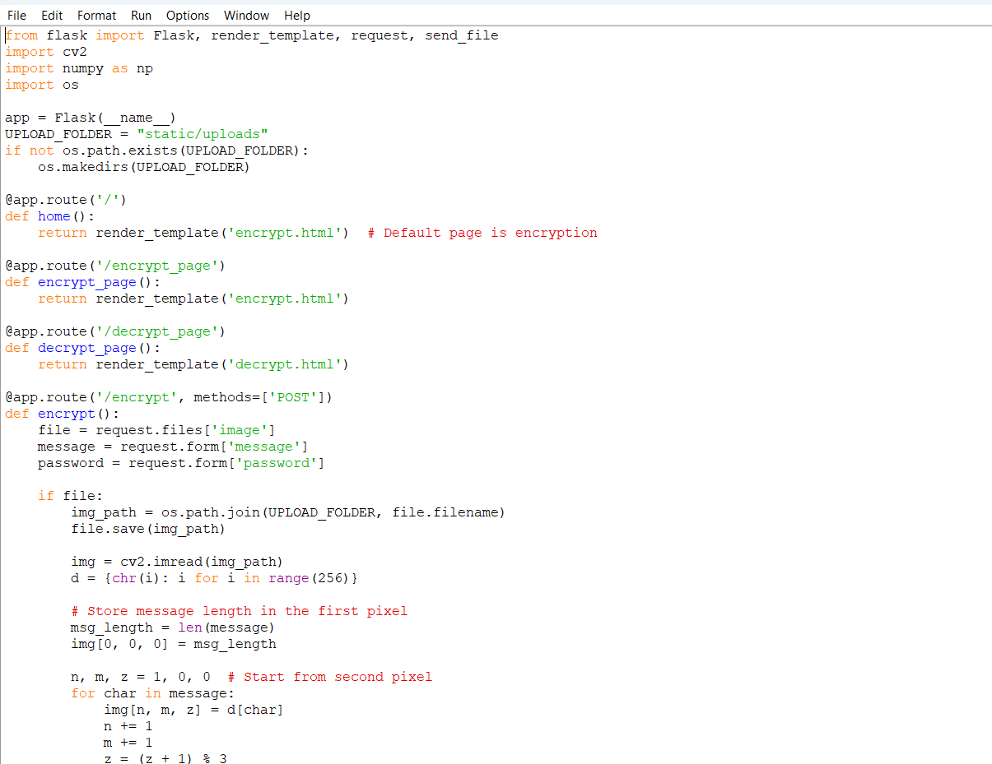
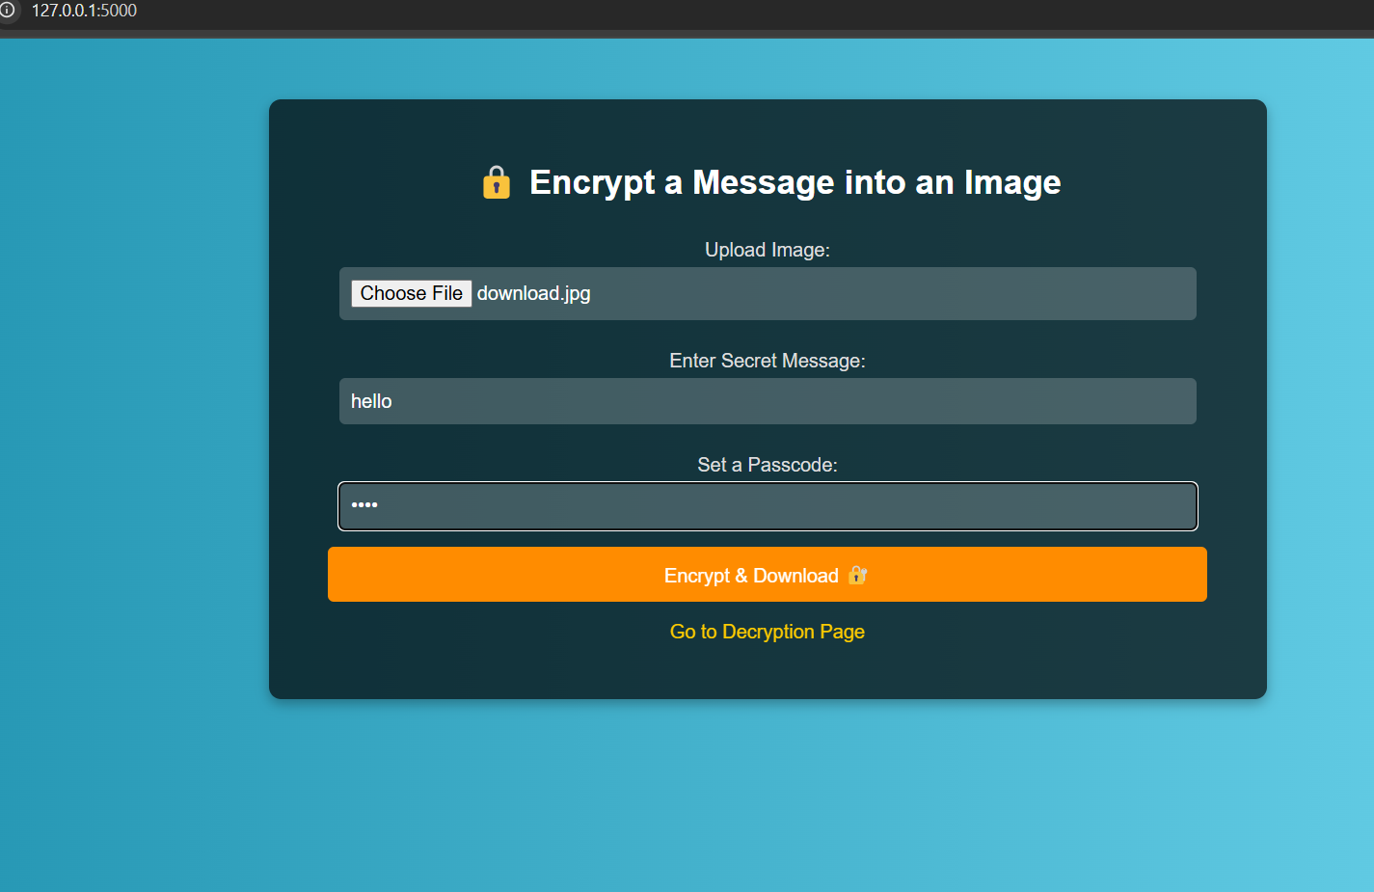
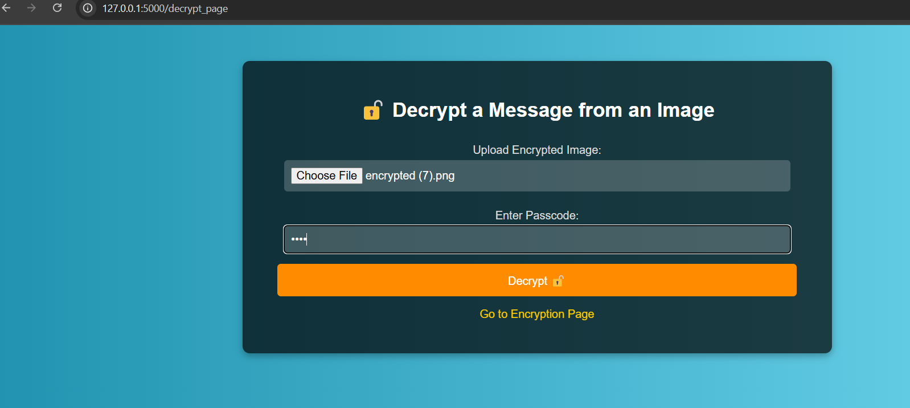
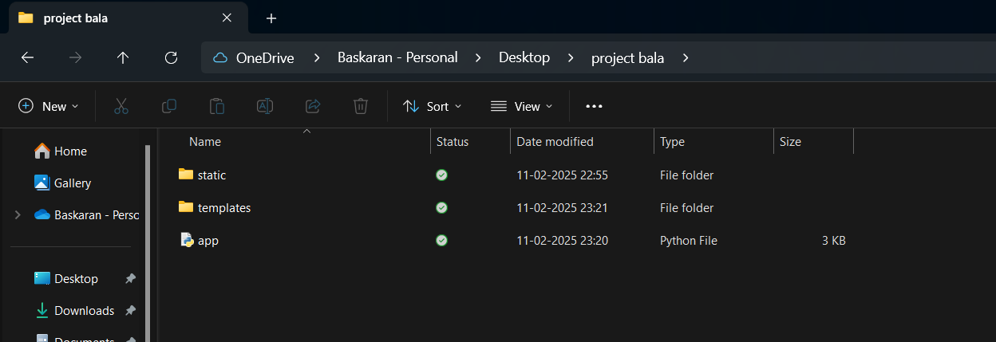
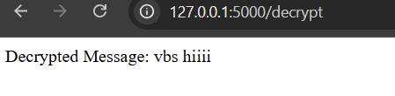
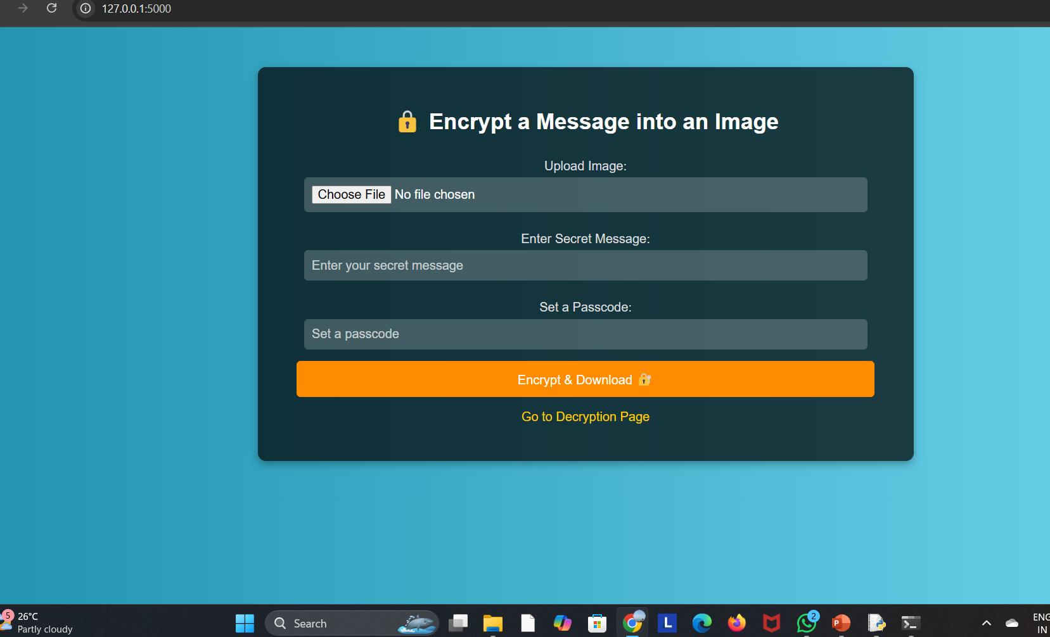
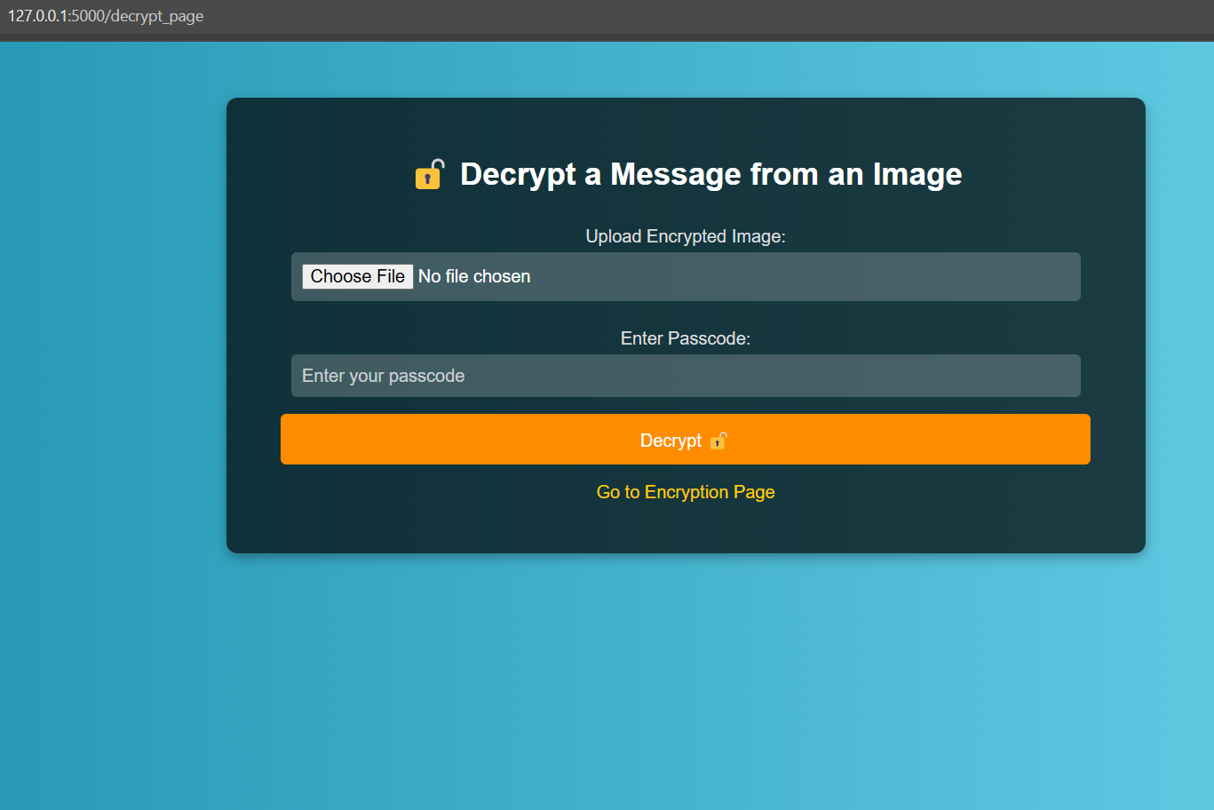
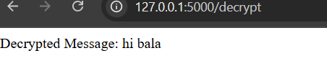
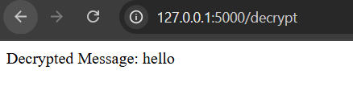
RESULTS

Slide 8
CONCLUSION
This project successfully addresses the challenge of secure data transmission by integrating AES encryption with LSB steganography. By encrypting messages before embedding them in images, it ensures that even if extracted, the data remains unreadable without the correct key. The user-friendly GUI enhances accessibility, allowing anyone to securely hide and retrieve messages without technical expertise.
With applications in cybersecurity, forensics, secure messaging, and intellectual property protection, this project provides a practical, efficient, and secure method for confidential communication.

Slide 9
GITHUB LINK
https://github.com/Balasubramanian1503/AICTE-PROJECT.git

Slide 10
FUTURE SCOPE(OPTIONAL)
1. Support for Multiple File Types – Extend steganography to hide data in audio, video, and PDF files.
2. Advanced Encryption Techniques – Implement stronger encryption methods like RSA or hybrid encryption for enhanced security.
3. AI-Based Steganalysis Prevention – Improve security against AI-powered detection techniques.
4. Cloud Integration – Enable secure online storage and retrieval of hidden messages.
5. Mobile App Development – Develop an Android/iOS app for easy access on mobile devices.
6. Multi-Layer Steganography – Embed data across multiple images for increased protection.
7. Blockchain for Verification – Use blockchain technology to verify message authenticity and prevent tampering.

Slide 11
THANK YOU

